Slide 1

Women Yes Women Tech Gala – Fundraising - Awareness
Leveraging NYC Subway Data to Optimize Participation, Fundraising, and Awareness

Slide 2
Objectives
Build awareness and reach
Get attendees for Gala
Reach out to potential contributors
ACTION:
Collect email addresses from relevant populations

Slide 3
Defining our Target Stations
Awareness
Participation
Fundraising
Heavily trafficked Stations
Goal: Maximize Awareness
Stations close to target institutions
Goal: Maximize Participation & Promote Outreach
Stations in wealthy neighborhoods
Goal: Maximize Fundraising

Slide 4
Leveraging Subway Data - Process
Data Sources:
MTA turnstile data (range used: 4 weeks starting 06/17/17)
MTA subway station geolocation
Census data
NYC Open Data Zipcode Geolocation
Data Tools:
Python libraries
Seaborn
Folium
JS libraries

Slide 5
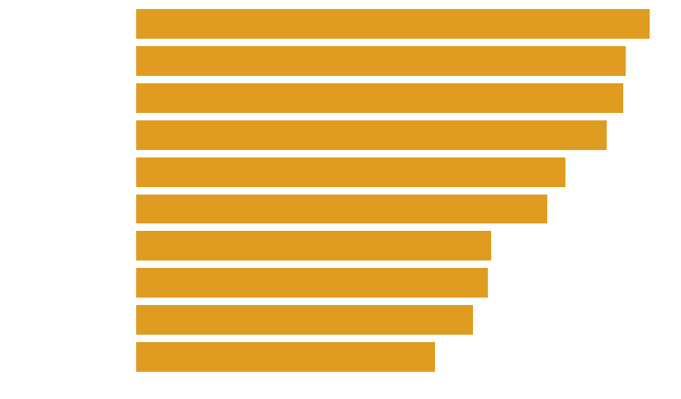
Most Trafficked Stations - Top 10
Total Flow

Slide 6


Significant Variability

Slide 7

Maximizing Participation – 116th St. Case Study
Average People per hour
Hours

Slide 8



Maximizing Fundraising – 86th St. Case Study
Average People per hour
Hours
Average People per hour
Average People per hour
Hours
Hours

Slide 9



Maximizing Awareness – 42nd St. Case Study
Average People per hour
Hours
Average People per hour
Average People per hour
Hours
Hours

Slide 10
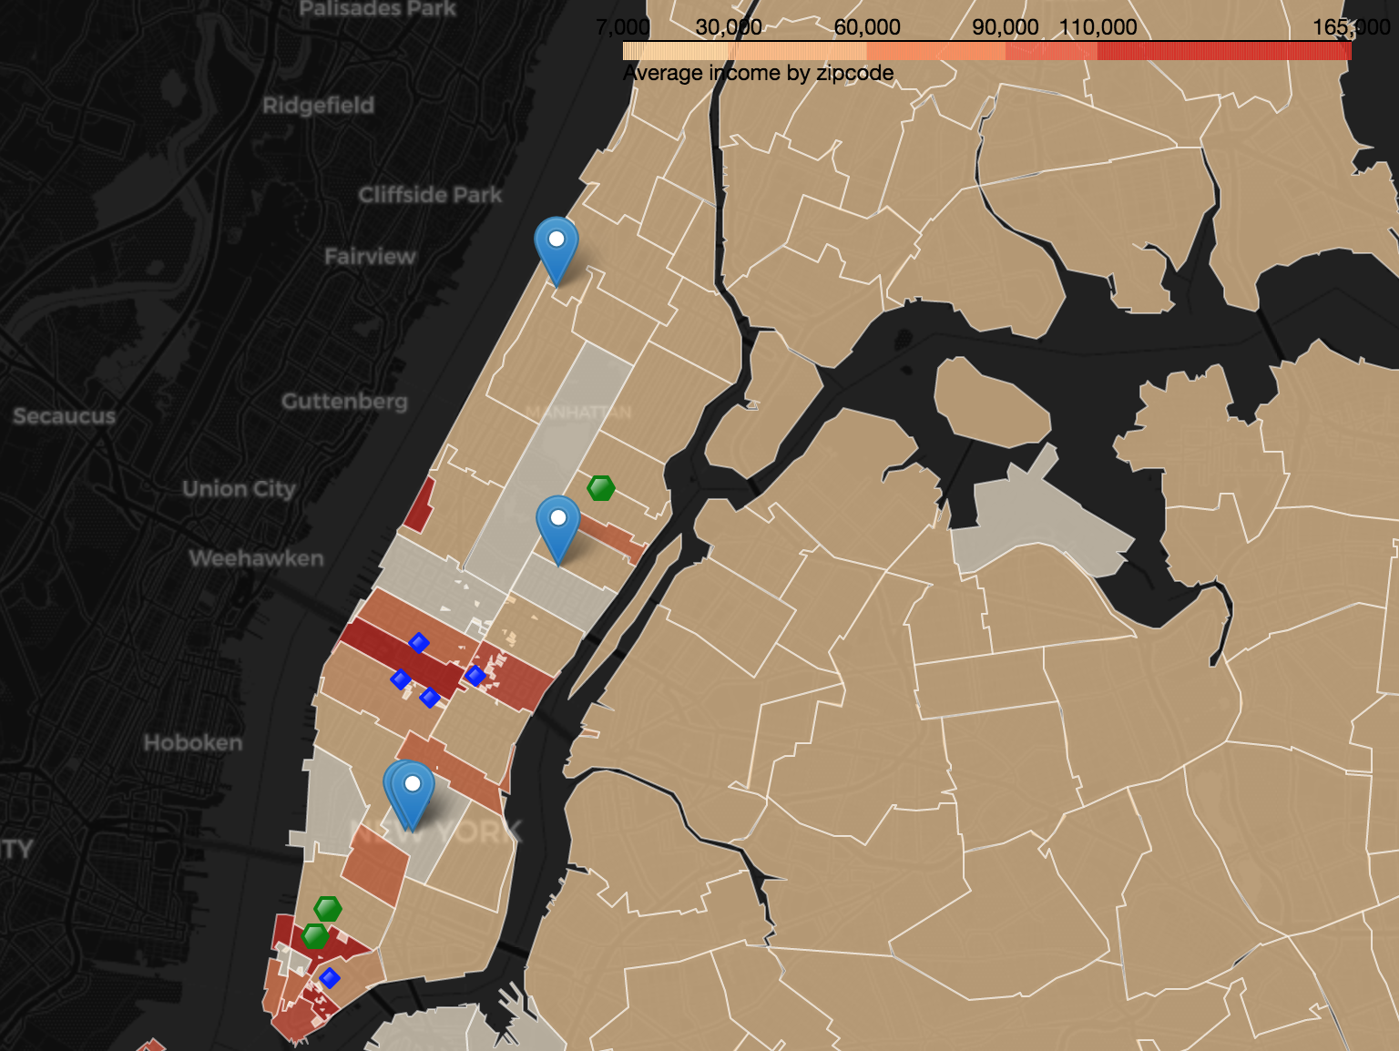
Overlapped Objectives

Slide 11
Target Stations Recommended
Awareness
Participation
Fundraising
42 St. Port Authority
Grand Central
Herald Sq.
Fulton St.
Union Sq.
Penn Station
116th St. Columbia
8th St. NYU
68th St - Hunter
Astor Pl.
86th St.
Franklin St.
Chambers St.

Slide 12
Next Steps…
Develop marketing plan based on size of teams, budget, and heatmaps
Increase size of data to broaden time series
Consider looking at demographic data to increase diversity sampling
Incorporate psychology modeling to maximize outcomes

Slide 13

Thank You – Q&A

